Slide 1
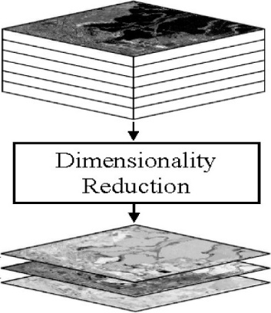
Principal component analysis

Slide 2
PCA
Principle
Linear projection method to reduce the number of parameters
Transfer a set of correlated variables into a new set of uncorrelated variables
Map the data into a space of lower dimensionality
Form of unsupervised learning
Properties
It can be viewed as a rotation of the existing axes to new positions in the space defined by original variables
New axes are orthogonal and represent the directions with maximum variability

Slide 3
Principal components
First principal component is the direction of greatest variability (covariance) in the data
Second is the next orthogonal (uncorrelated) direction of greatest variability
So first component removes all the variability along the first component, and then find the next direction of greatest variability
And so on …

Slide 4
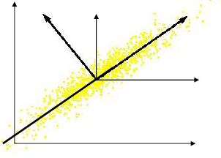
Computing the components
Data points are vectors in a multidimensional space
Projection of vector x onto an axis (dimension) u is u.x
Direction of greatest variability is that in which the average square of the projection is greatest
This direction of u is the direction of the first Principal Component

Slide 5
PCs, Variance and Least-Squares
The first PC retains the greatest amount of variation in the sample
The kth PC retains the kth greatest fraction of the variation in the sample
The kth largest eigenvalue of the correlation matrix C is the variance in the sample along the kth PC
The least-squares view: PCs are a series of linear least squares fits to a sample, each orthogonal to all previous ones

Slide 6
How many PCs?
For n original dimensions, correlation matrix is nxn, and has up to n eigenvectors. So n PCs.
Where does dimensionality reduction come from?

Slide 7
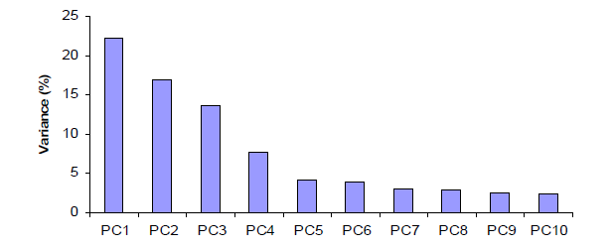
Dimensionality Reduction
Can ignore the components of lesser significance.
You do lose some information, but if the eigenvalues are small, you don’t lose much
n dimensions in original data
calculate n eigenvectors and eigenvalues
choose only the first p eigenvectors, based on their eigenvalues
final data set has only p dimensions

Slide 8
PCA Example –STEP 1
Subtract the mean
From each of the data dimensions. All the x values have x subtracted and y values have y subtracted from them. This produces a data set whose mean is zero.
Subtracting the mean makes variance and covariance calculation easier by simplifying their equations. The variance and co-variance values are not affected by the mean value.

Slide 9
PCA Example –STEP 1
ORIGINAL DATA:
x y
2.5 2.4
0.5 0.7
2.2 2.9
1.9 2.2
3.1 3.0
2.3 2.7
2 1.6
1 1.1
1.5 1.6
1.1 0.9
ZERO MEAN DATA:
x y
.69 .49
-1.31 -1.21
.39 .99
.09 .29
1.29 1.09
.49 .79
.19 -.31
-.81 -.81
-.31 -.31
-.71 -1.01

Slide 10
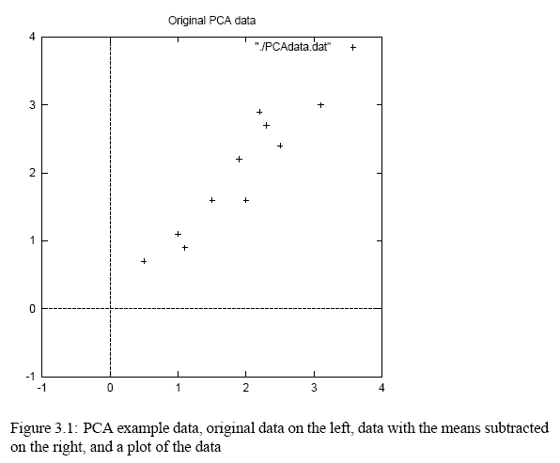
PCA Example –STEP 1

Slide 11
PCA Example –STEP 2
Calculate the covariance matrix
cov = .616555556 .615444444
.615444444 .716555556
Since the non-diagonal elements in this covariance matrix are positive, we should expect that both the x and y variable increase together.

Slide 12
PCA Example –STEP 3
Calculate the eigenvectors and eigenvalues of the covariance matrix
eigenvalues = .0490834
1.2840277
eigenvectors = -.735178656 -.677873399
.677873399 -.735178656

Slide 13
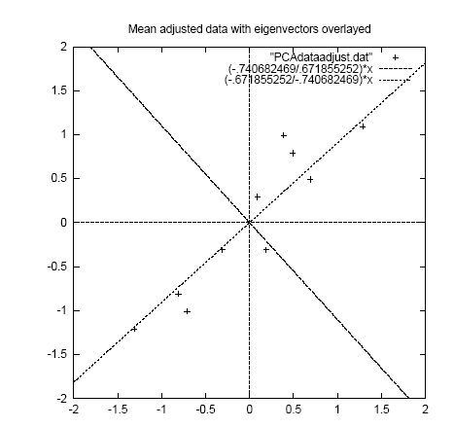
PCA Example –STEP 3
eigenvectors are plotted as diagonal dotted lines on the plot.
Note they are perpendicular to each other.
Note one of the eigenvectors goes through the middle of the points, like drawing a line of best fit.
The second eigenvector gives us the other, less important, pattern in the data, that all the points follow the main line, but are off to the side of the main line by some amount.

Slide 14
PCA Example –STEP 4
Reduce dimensionality and form feature vector
The eigenvector with the highest eigenvalue is the principle component of the data set.
In our example, the eigenvector with the largest eigenvalue was the one that pointed down the middle of the data.
Once eigenvectors are found from the covariance matrix, the next step is to order them by eigenvalue, highest to lowest. This gives you the components in order of significance.

Slide 15
PCA Example –STEP 4
Now, if you like, you can decide to ignore the components of lesser significance.
You do lose some information, but if the eigenvalues are small, you don’t lose much
n dimensions in your data
calculate n eigenvectors and eigenvalues
choose only the first p eigenvectors
final data set has only p dimensions.

Slide 16
PCA Example –STEP 4
Feature Vector
FeatureVector = (eig1 eig2 eig3 … eign)
We can either form a feature vector with both of the eigenvectors:
-.677873399 -.735178656
-.735178656 .677873399
or, we can choose to leave out the smaller, less significant component and only have a single column:
- .677873399
- .735178656

Slide 17
PCA Example –STEP 5
Deriving the new data
FinalData = RowFeatureVector x RowZeroMeanData
RowFeatureVector is the matrix with the eigenvectors in the columns transposed so that the eigenvectors are now in the rows, with the most significant eigenvector at the top
RowZeroMeanData is the mean-adjusted data transposed, ie. the data items are in each column, with each row holding a separate dimension.

Slide 18
PCA Example –STEP 5
FinalData transpose: dimensions along columns
x y
-.827970186 -.175115307
1.77758033 .142857227
-.992197494 .384374989
-.274210416 .130417207
-1.67580142 -.209498461
-.912949103 .175282444
.0991094375 -.349824698
1.14457216 .0464172582
.438046137 .0177646297
1.22382056 -.162675287

Slide 19
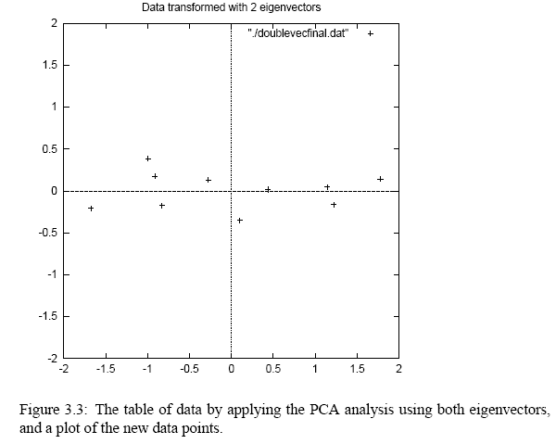
PCA Example –STEP 5

Slide 20
Reconstruction of original Data
If we reduced the dimensionality, obviously, when reconstructing the data we would lose those dimensions we chose to discard. In our example let us assume that we considered only the x dimension…

Slide 21
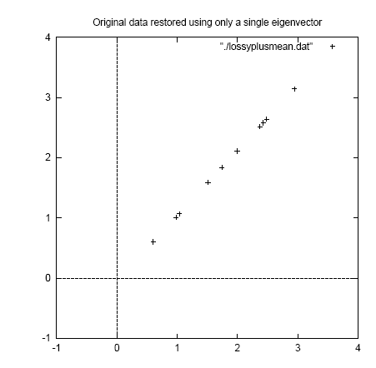
Reconstruction of original Data
x
-.827970186
1.77758033
-.992197494
-.274210416
-1.67580142
-.912949103
.0991094375
1.14457216
.438046137
1.22382056

Slide 22
PCA link
http://setosa.io/ev/principal-component-analysis/

